Slide 1
Height Estimation in Surveillance Video
Final Review
Group : Videre

Slide 2
Outline
Approach
Approach 1
Approach 2
Our Approach
Results
Conclusion

Slide 3
Previous Work, Approach 1
We have tried to incorporate the nonlinear regression method to do the camera calibration followed by the HoG + SVM to detect the human. Once, we got the bounding box. We have computed the difference between foot and head points of the bounding box and estimate the height and assigned category.
Issue: Most of the time (HoG + SVM) gives many false positives. Difficult to detect person perfectly. Segmentation is required.
Further: Applied GrabCut for the segmentation using bounding box. Results were poor.

Slide 4
Approach 2 - Using Segmentation + HoG
We have tried various segmentation approaches.
Problems
GrabCut: Required bounding box. (If we give HoG+SVM, Results were poor, Since, we want an automatic way of height estimation, GrabCut does not suit for that purpose. Difficult to give proper box, considering movements are random)
RPCA: In terms of computation, it is extremely difficult to process high resolution videos. Not suitable at all for surveillance.
Frame Differencing: Suitable way for our requirement. Thus, we have opted it for the segmentation.

Slide 5
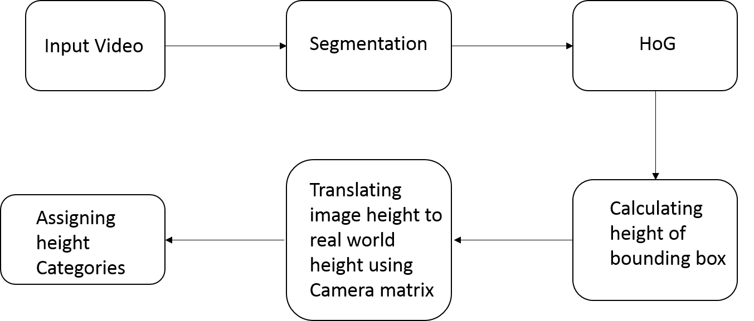
Our Approach

Slide 6
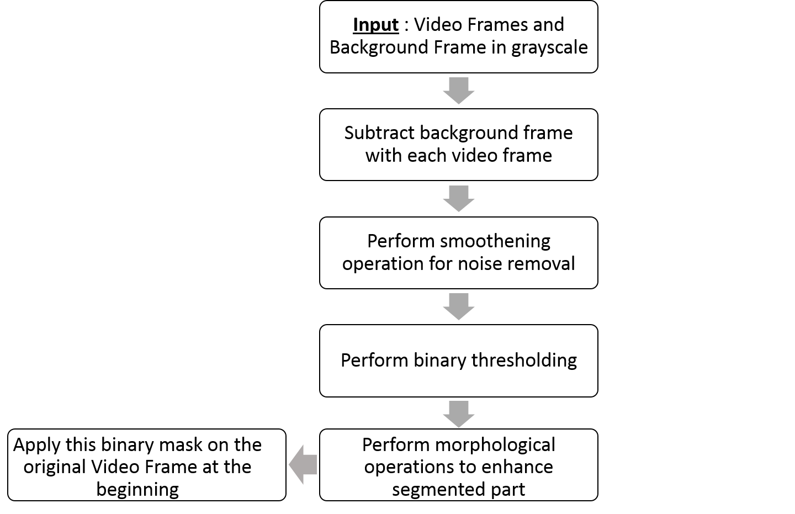
Segmentation Method

Slide 7
Results

Slide 8
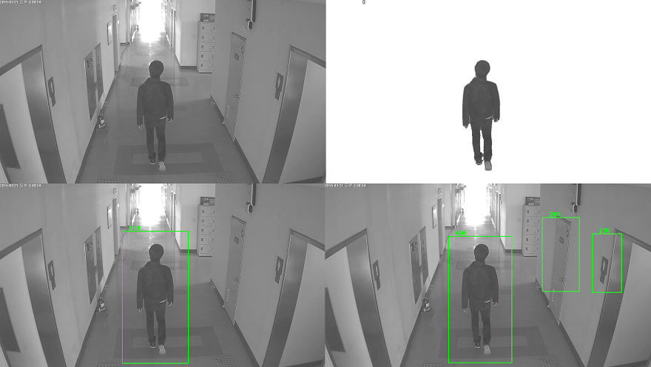
Successful Result
Moving clockwise from top left : 1). Original, 2). Segmented using our method,
3). Person Detection and and image height measurement using HOG only, 4). Person detection and image height measurement using Our Segmentation + HOG

Slide 9
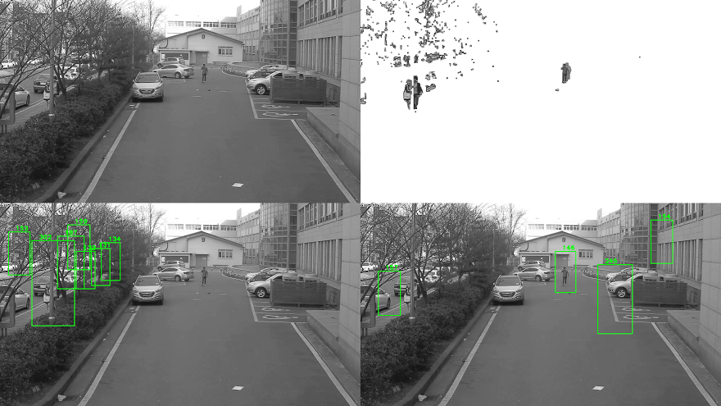
Failure when person is far away, presence of noises like moving trees and unavailability of background frame
Moving clockwise from top left : 1). Original, 2). Segmented using our method,
3). Person Detection and and image height measurement using HOG only 4). Person detection and image height measurement using Our Segmentation + HOG

Slide 10
Results of Detection for Other Cameras

Slide 11
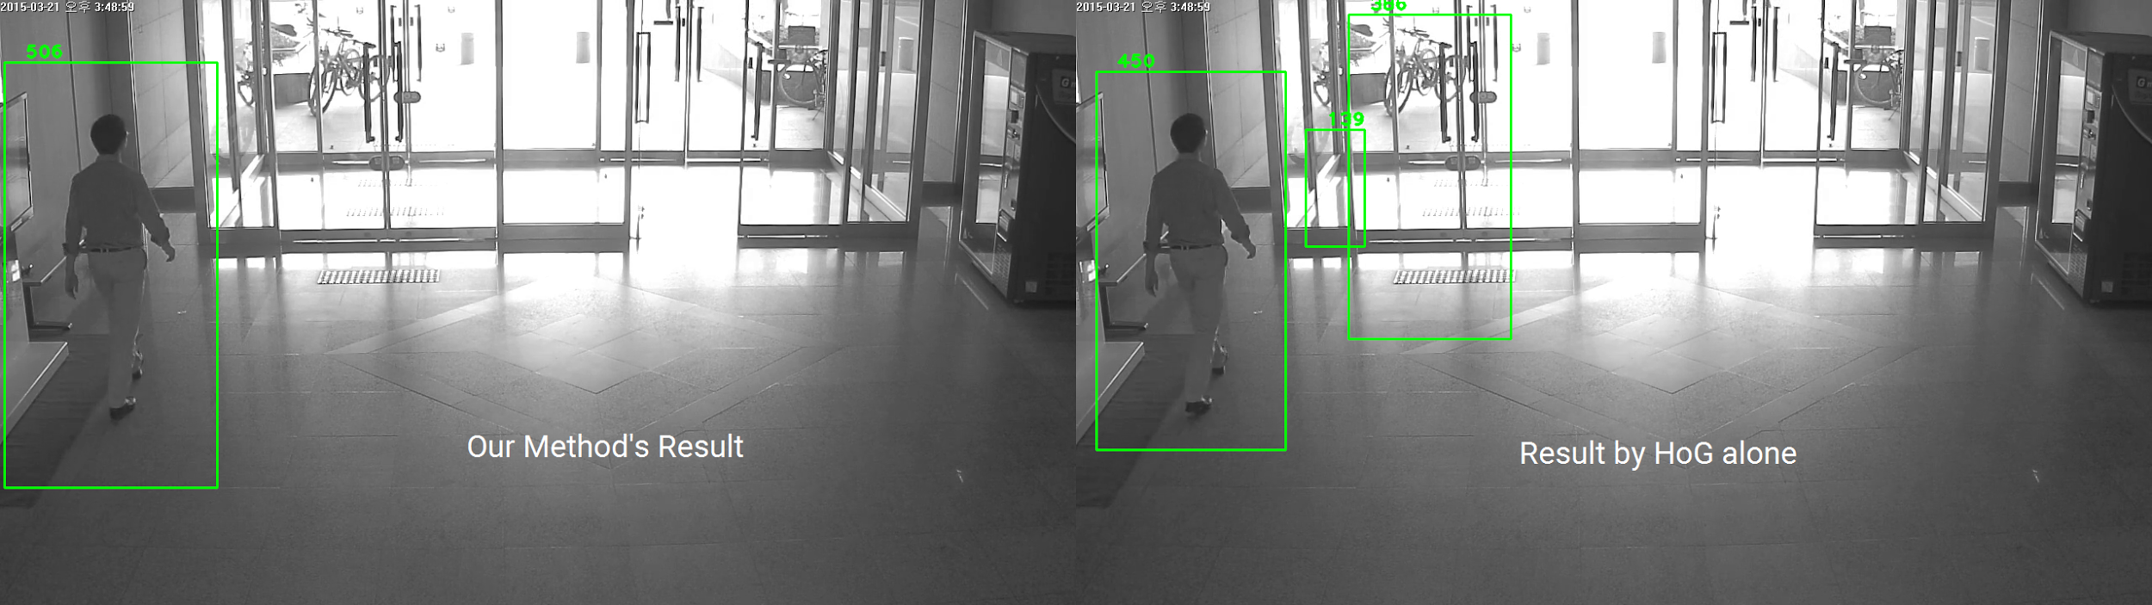
Camera 04

Slide 12
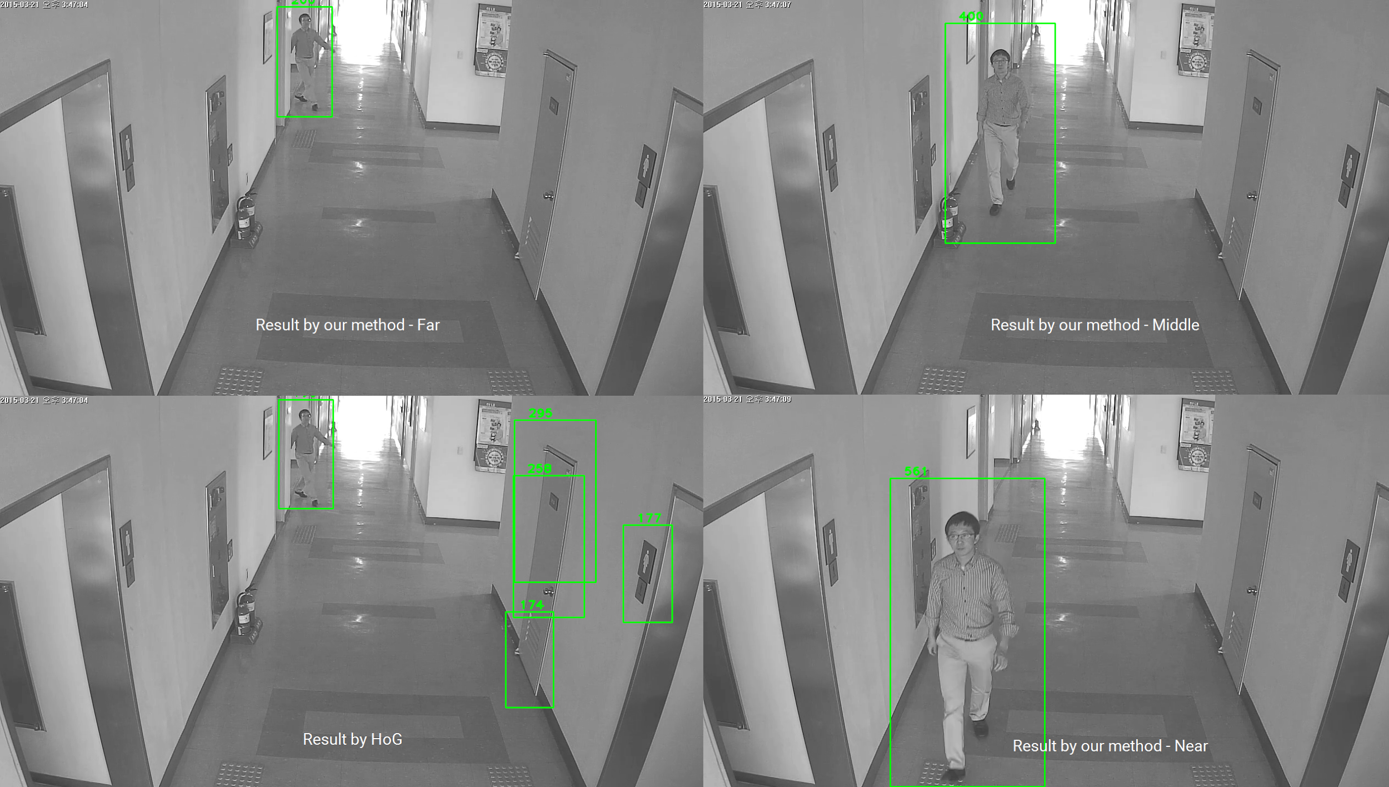
Camera 08

Slide 13
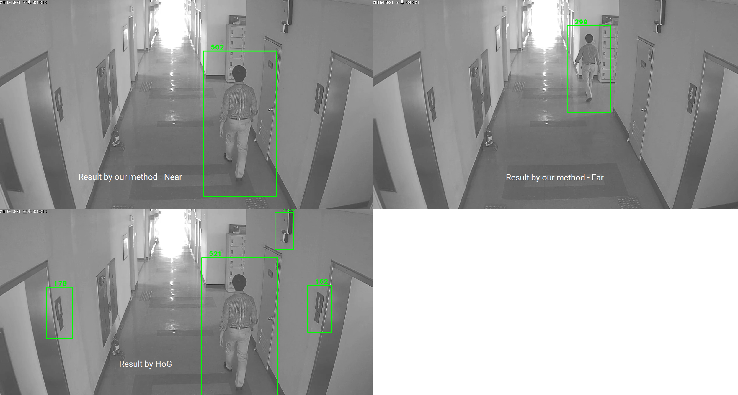
Camera 10

Slide 14
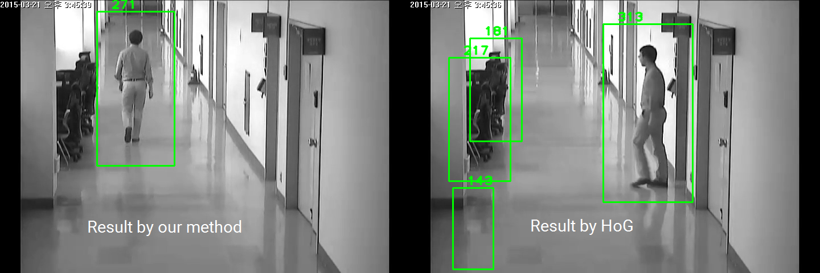
Camera 11

Slide 15
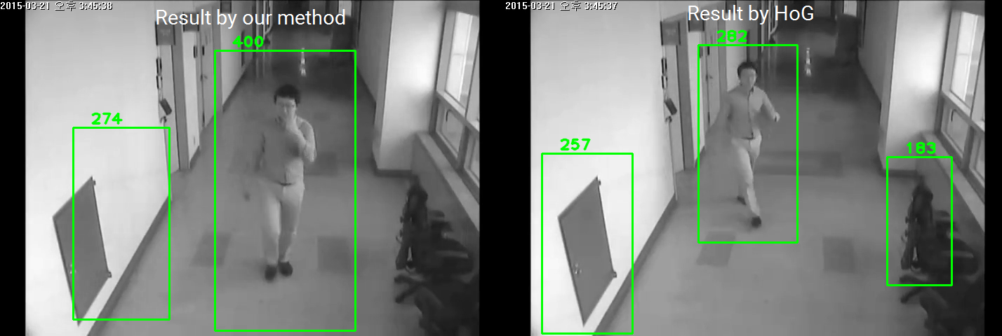
Camera 12

Slide 16
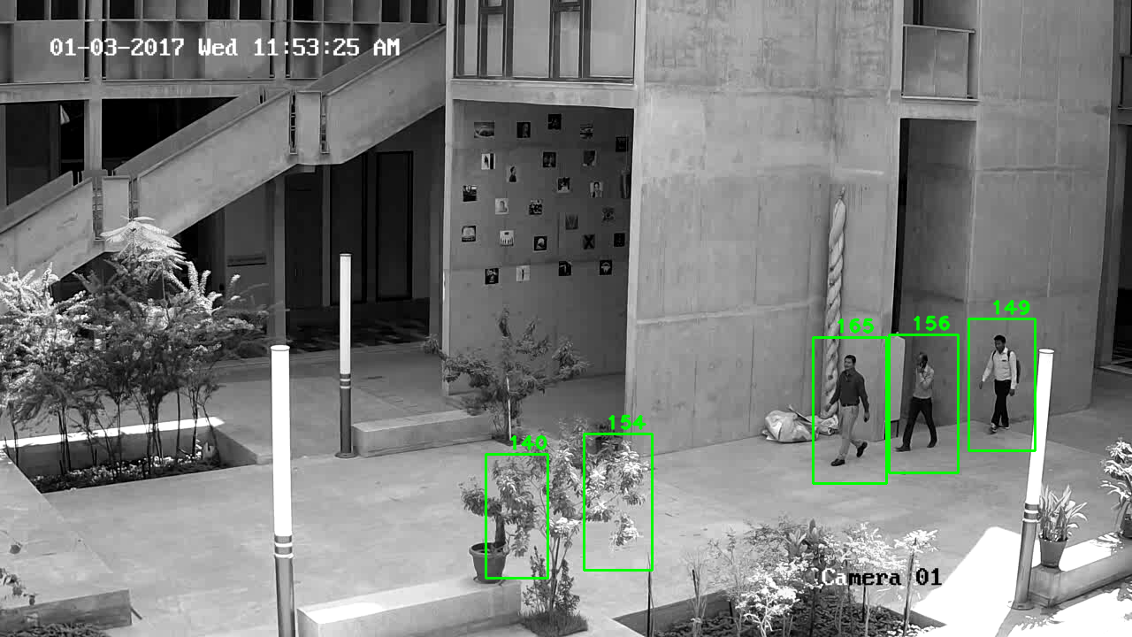
Result of video taken at SEAS campus
Result by our method

Slide 17
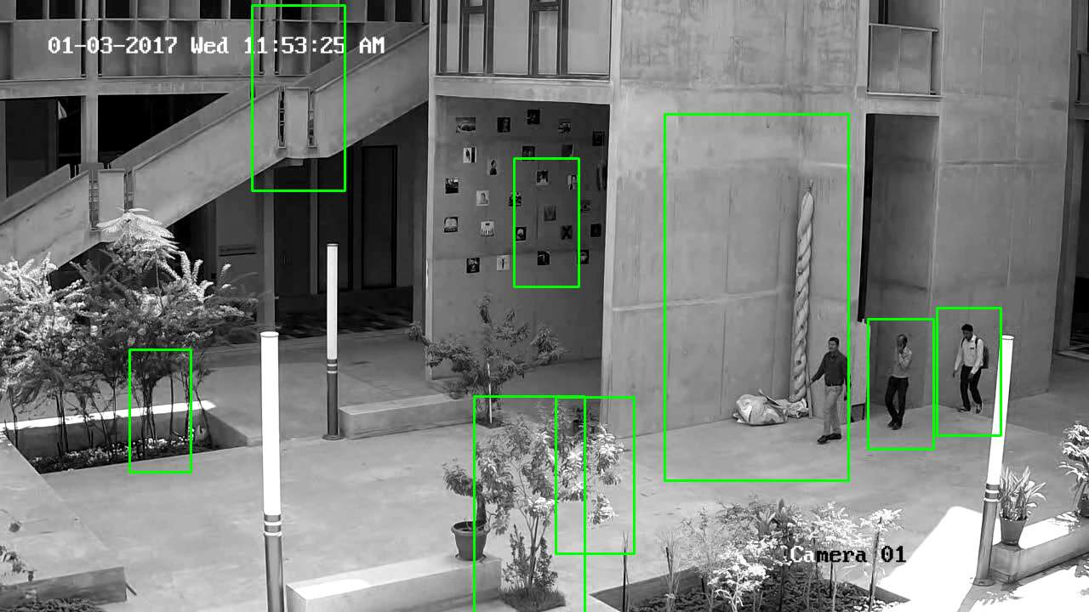
Result of video taken at SEAS campus
Result by HoG method

Slide 18
Limitations of our approach
Requires clear background frame for differencing with subsequent frames.
Person standing farther is not detected sometimes.
Swinging plants or trees due to wind, acts as noise for our model (motion segmentation necessary)

Slide 19
Conclusion
Environment is ideal : Camera Calibration is done easily and thus, traditional height estimation algorithms work fine.
But,
An automated height estimation problem requires segmentation. So, a perfect segmentation is the key along with some rough information about the distance of the person from the camera.

Slide 20
Reference
[1]. P Tome, J Fierrez, R Vera-Rodriguez, M Nixon, Soft biometrics and their application in person recognition at a distance. IEEE Trans. Inf. Forensics. Secur. 9(3), 464–475 (2014)
[2]. SX Yang, PK Larsen, T Alkjaer, B Juul-Kristensen, EB Simonsen, N Lynnerup, Height estimations based on eye measurements throughout a gait cycle. Forensic. Sci. Int. 236(0), 170–174 (2014)
[3]. G. Edelman, I. Alberink, B. Hoogeboom, Comparison of the performance of two methods for height estimation, Journal of Forensic Sciences 55 (2010) 358–365.
[4]. B Micusik, T Pajdla, in IEEE Conference on Computer Vision and Pattern Recognition (CVPR). Simultaneous surveillance camera calibration and foot-head homology estimation from human detections (IEEE, 2010), pp. 1562–1569
[5]. Li, Shengzhe, et al. “A simplified nonlinear regression method for human height estimation in video surveillance.” EURASIP Journal on Image and Video Processing 2015.1(2015):32

